Slide 1
Synchronisation And Locking Primitives
Akshat Arun - 190101007

Slide 2
Synchronisation And Locking Primitives in xv6
No thread libraries are implemented in xv6, so no 2 user programs can access the same user space memory image so no need of locks are there and hence the user space lacks locking primitives.
However there is scope of concurrency in the kernel space processes. Two processes in kernel mode in different CPU cores can access the same kernel data structures.
There are 2 types of locking primitives in xv6:-
Spinlocks
Sleeplocks

Slide 3
Spinlocks in xv6
It is a binary lock and allows only one process at a time to access the shared data while the other processes who requested for the lock are trapped in a busy waiting while loop, till the process who held the lock releases it.
It implements the busy waiting using xchg atomic instructions.
The code for this lock mainly reside in 2 files:-
Spinlock.h
Spinlock.c

Slide 4
Sleeplocks in xv6
It is also a binary lock and allows only one process at a time to access the shared data while the other processes who requested for the lock are sleeping on a channel, till the process who held the lock releases it.
When a process needs to hold a lock for a very long time then we use sleeplocks.
Xv6 uses spin-locks in most situations, since they have low overhead. It uses sleep-locks only in the file system because of lengthy disk operations.
The code for this lock mainly reside in 2 files:-
Sleeplock.h
Sleeplock.c

Slide 5
Synchronisation And locking primitives in linux
Prior to Version 2.6, Linux was a nonpreemptive kernel, meaning that a process running in kernel mode could not be preempted even if a higher priority process became available to run. Now, however, the Linux kernel is fully preemptive, so a task can be preempted when it is running in the kernel.
Linux provides several different locking primitives for synchronization in the kernel:-
Spinlocks
Queued spinlocks
Counting sleep semaphores
Sleep Mutexes
Read-Write latch
Sequential lock

Slide 6
Feature 1
We will be implementing the Counting Sleep Semaphores in xv6.
Suppose we have a critical section and multiple processes which want to read data from that critical section then its not required that they read one by one rather they can read from it concurrently.
So for this we can implement the counting sleep semaphores in xv6 which is taken from the linux os.

Slide 7
Counting sleep Semaphores
Because it's a counting semaphore, multiple processes can concurrently access the critical section.
And because its a sleep semaphore, any process which was not able to acquire the lock will not be busy waiting but rather will be sleeping on a channel.
And when the value of the semaphore is positive again then one of the processes sleeping on a channel is woken up.

Slide 8
Implementation of Counting sleep Semaphores
We will firstly form the data structure which will be storing the required data of the semaphore.(In a separate file semaphore.h)
So we will have a struct with the following parameters:-
Val - The initial value of the semaphore, denoting how many processes can access the critical section at a time.
Lock - The spinlock which will be used as the lock.
Chan - A circular queue of channels which we will be using as the sleeping channels, where the processes sleep.
ChanLock - An array of spinlocks for all of the sleeping channels.
Head - The head pointer of the circular queue.
Tail - The tail pointer of the circular queue.

Slide 9
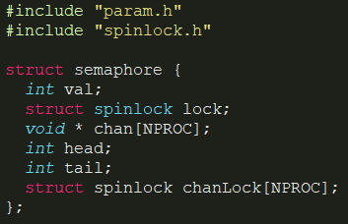
Structure of the Semaphore
(Explanation of all of the codes in ppt is given in the report and in the video)

Slide 10
Now we will have 4 methods defined in semaphore.c which our semaphore can use:-
Sem_init - It will help us in initialising our newly declared semaphore.
Sem_wait - It will make a process wait if the current value of the counting semaphore is equal to zero else it will let the process access the critical section/resource which it requested and will also decrement the value of the semaphore..
Sem_signal - It will increase the semaphore value by one and will also wakeup the process sleeping at the head pointer of our circular queue so that it can then access the critical section.
Sem_broadcast - It is a method created in order to wake up all of the processes sleeping inside the circular queue’s channels while also signalling the semaphore at the same time. Basically broadcast to all the sleeping processes that the semaphore is now available.

Slide 11
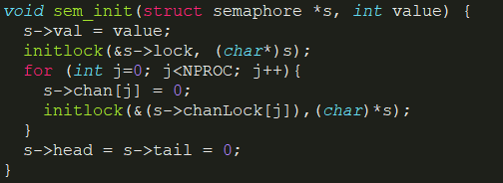
Initialization of the semaphore

Slide 12
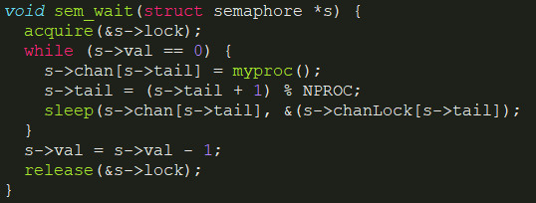
Wait for the Semaphore

Slide 13
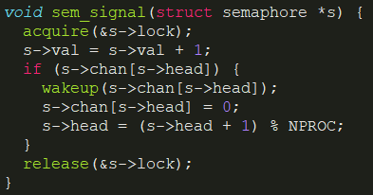
Signal of the Semaphore

Slide 14
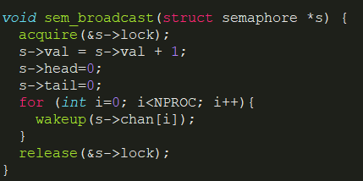
Broadcasting of the Semaphore

Slide 15
Feature 2
We will be implementing mutex locks with sleep feature because linux’s mutexes also has this.
Mutex locks are almost similar to spinlocks except the fact that mutex locks can only be released by the process which acquired the lock whereas this is not the case in spinlocks.
Spinlocks just check while releasing that whether the processor of my current running process is the same to the processor on which the lock was acquired or not.
And sleeplocks do not even check the processor.

Slide 16
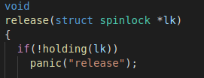
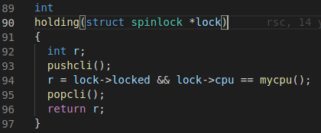
Release in spinlock.c of xv6

Slide 17
Implementation of Sleep Mutex locks
We will firstly form the data structure which will be storing the required data of the mutex lock.(In a separate file mutex.h)
So we will have a struct with the following parameters:-
Locked - A boolean variable telling whether the mutex lock is locked or not.
Lock - The spinlock which will be used as the lock.
Chan - A circular queue of channels which we will be using as the sleeping channels, where the processes sleep.
ChanLock - An array of spinlocks for all of the sleeping channels.
Head - The head pointer of the circular queue.
Tail - The tail pointer of the circular queue.
Owner - It will be pointing to the process which held the lock.

Slide 18
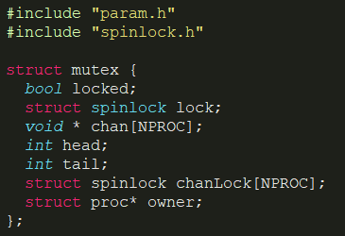
Structure of the Mutex

Slide 19
Now we will be having 3 methods for the mutex locks:-
Mutex_init - This will be used to initialise the mutex lock.
Mutex_lock - This will be used to acquire the mutex lock by the current process.
Mutex_unlock - This will be used to release the mutex lock by the current process.

Slide 20
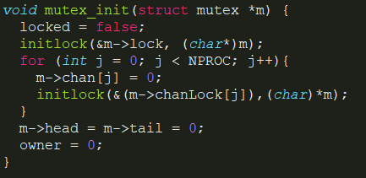
Initialization of the Mutex

Slide 21
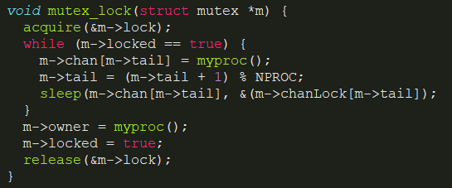
Locking of the Mutex

Slide 22
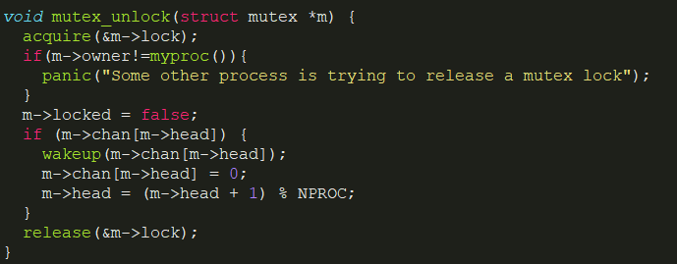
Unlocking of the Mutex

Slide 23
Bibliography
https://pdos.csail.mit.edu/6.828/2018/xv6/book-rev11.pdf
https://0xax.gitbooks.io/linux-insides/content/SyncPrim/linux-sync-4.html
https://www.cse.iitb.ac.in/~mythili/os/anno_slides/lecture29.pdf
Silberschatz, A., Galvin, P., Gagne, G.. (2018) Operating System Concepts. John Wiley and Sons. pp. 803-807.

Slide 24
Thank You!

